Slide 1


Slide 2

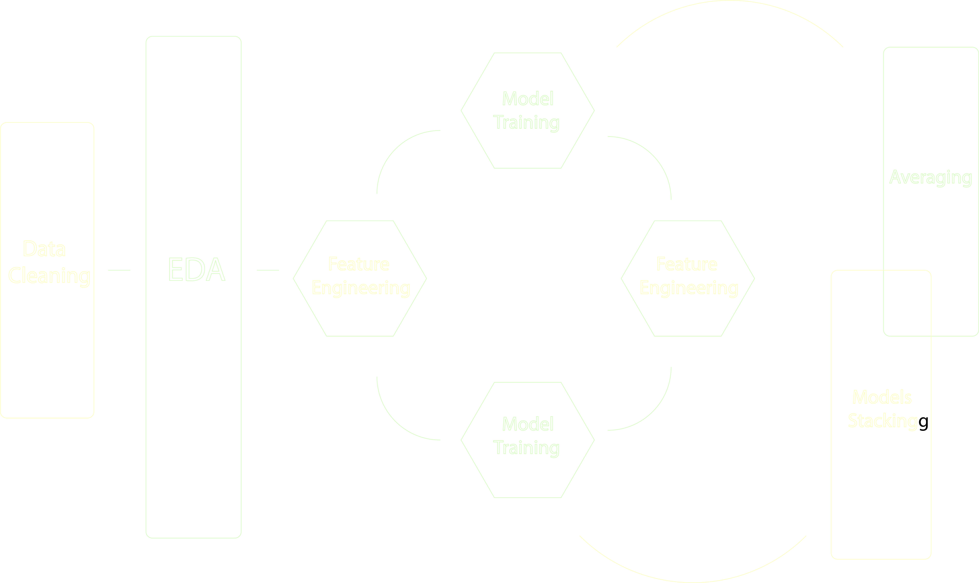
Workflow

Slide 3
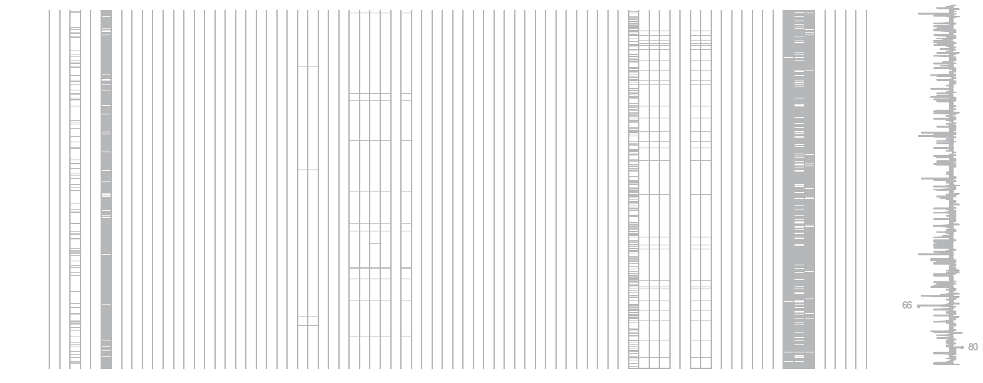
Missing Data

Slide 4
Missing Data
LotFrontage: Use median LotFrontage of the HouseStyle instead of Neighborhood.
MSE:
BldgType, MSZoning : 682
Neighborhood: 641
MSZoning, HouseStyle: 574
HouseStyle: 515

Slide 5
EDA and Feature Engineering
Add indicator variables such as Remodel, Pool
Add Bsmt finished percentage
Combine certain area fields – Bsmt, Porch
Subtract MiscVal from SalePrice and drop from train set and test set and add it back to our result after prediction
Handle columns like Exterior2, Condition2 and BsmtFinType2 which provide additional information to the columns end with “1”
Apply log transformation to area fields

Slide 6
Feature Engineering
EDA and Feature Engineering
MSSubClass, Neighborhood

Slide 7
EDA and Feature Engineering
Categorical Features
Features with a natural order
Label Encode
Features with no natural order
dummify

Slide 8
Feature Engineering
EDA and Feature Engineering
YearBuilt
Price:
1950 before and after

Slide 9
EDA and Feature Engineering
YearRemoAdd
1950
Set 1950 as 0. 1951 as 1, 1952, as 2 ….
And drop the YearBuilt column

Slide 10
EDA and Feature Engineering
MoSold and YrSold
YearSold ANOVA test: p-value is 0.565637.
Drop column
ANOVA test for the 12 months: p-value, 0.4833
Drop column

Slide 11
EDA and Feature Engineering
Minor class Cut-off
Dumified Features was reduced from 241 to 148.
Cut-off n_observations: 73
33 | -0.062535 | MSSubClass_160
59 | -0.071916 | LotShape_IR3
233 | -0.078051 | Heating_Grav
82 | -0.082950 | Neighborhood_IDOTRR
253 | -0.137332 | Functional_Maj2
130 | -0.147123 | OverallCond_3
257 | -0.214202 | Functional_Sev
293 | -0.283140 | PoolQC_Gd
111 | -0.508852 | Condition2_PosN

Slide 12
EDA and Feature Engineering
Unbalanced Coefficients
 | coef | Features
13 | 0.348589 | GrLivArea
46 | 0.081421 | MSZoning_FV
47 | 0.081205 | MSZoning_RL
68 | 0.073664 | Neighborhood_Crawfor
1 | 0.071194 | LotArea
Log of GrLivArea.
Alpha = 3.51
R²: 0.927
K-RMSE: 0.12622
Sqrt of GrLivArea
Alpha: 12.33
R²: 0.91
K-RMSE: 0.12524
 | coef | Features
68 | 0.066572 | Neighborhood_Crawfor
75 | 0.065793 | Neighborhood_NridgHt
1 | 0.063859 | LotArea
82 | 0.063691 | Condition1_Norm
47 | 0.061605 | MSZoning_RL

Slide 13
EDA and Feature Engineering
Leverage effect of ‘0’ group
PorchArea
Create another Boolean feature as flag
Try to tune the difference between 0 and others to the smallest.( decrease the leverage effect)

Slide 14

Models
Ridge
 | coef | Features
68 | 0.066962 | Neighborhood_Crawfor
75 | 0.066142 | Neighborhood_NridgHt
1 | 0.064017 | LotArea
82 | 0.063864 | Condition1_Norm
47 | 0.062408 | MSZoning_RL
26 | 0.061589 | GarageCars
2 | 0.060614 | OverallQual
145 | 0.059713 | SaleCondition_Normal
46 | 0.057866 | MSZoning_FV
98 | 0.057595 | Exterior1st_BrkFace
122 | 0.054103 | CentralAir_Y
119 | 0.050896 | Foundation_PConc
76 | -0.055342 | Neighborhood_OldTown
71 | -0.075893 | Neighborhood_IDOTRR
69 | -0.080432 | Neighborhood_Edwards
Alpha=11.9058
R²=0.9143
RMSE: 0.12524

Slide 15
Models
Lasso
 | coef | Features
46 | 0.094208 | MSZoning_FV
47 | 0.083330 | MSZoning_RL
75 | 0.073371 | Neighborhood_NridgHt
68 | 0.068136 | Neighborhood_Crawfor
1 | 0.067443 | LotArea
142 | 0.066819 | SaleType_New
82 | 0.066764 | Condition1_Norm
26 | 0.064287 | GarageCars
98 | 0.063051 | Exterior1st_BrkFace
145 | 0.060611 | SaleCondition_Normal
2 | 0.060532 | OverallQual
122 | 0.054471 | CentralAir_Y
119 | 0.053128 | Foundation_PConc
76 | -0.074949 | Neighborhood_OldTown
69 | -0.095586 | Neighborhood_Edwards
Alpha=0.00027
R²=0.9146
RMSE: 0.12588

Slide 16
Models
Random Forest
Grid Search
{'min_samples_leaf': 1,
'min_samples_split': 2,
'n_estimators': 300,
'random_state': 42}
R² = 0.873179352119
RMSE: 0.12925

Slide 17
Models
Gboost:
XGBoost:
Stacking:
Average the result from
different model:
Split?
0.12832
0.12792
0.12566
0.12419

